Slide 1

How does HTTPS work?
Navnath Damale | 24 Jan 2021

Slide 2
Prerequisites
You need to trust that public key cryptography & signature works:
Any message encrypted with A’s public key can only be decrypted with A’s private key.
Anyone with access to B’s public key can verify that a message (signature) could only have been created by someone with access to B’s private private key.

Slide 3
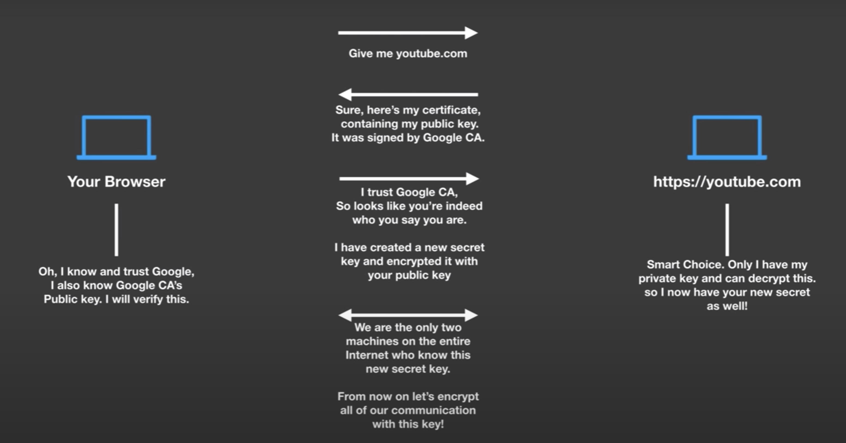

Slide 4
What is a Certificate Authority?
Sometimes referred to as a certification authority, is a company or organization that acts to validate the identities of entities (such as websites, email addresses, companies, or individual persons) and bind them to cryptographic keys through the issuance of electronic documents known as digital certificates. A digital certificate provides:
- Authentication, by serving as a credential to validate the identity of the entity that it is issued to.
- Encryption, for secure communication over insecure networks such as the Internet.
- Integrity of documents signed with the certificate so that they cannot be altered by a third party in transit.

Slide 5
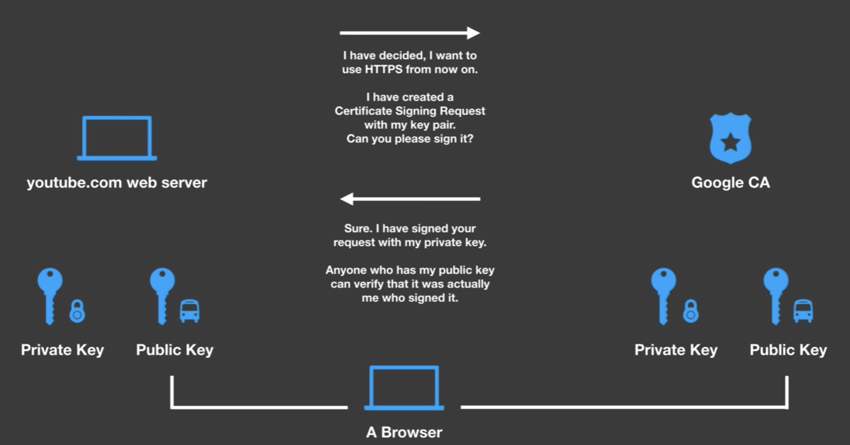

Slide 6
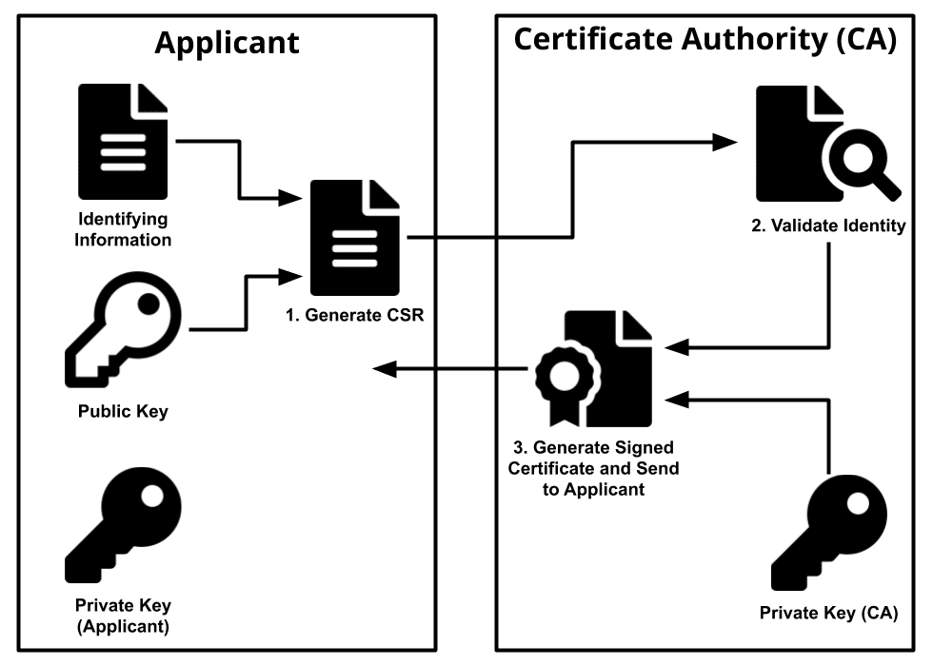
How is a certificate signed?

Slide 7
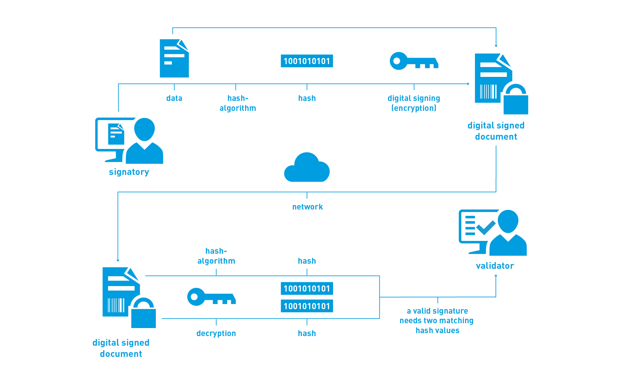
The Digital Signature

Slide 8
Digital Signature Vs Digital Certificate
Digital certificates - are used to validate the identity of the sender, and
Digital signatures - are used to validate the sent data.

